Slide 1
Bus-based Fabric
Anuparna Ganguly
23/02/2026

Slide 2
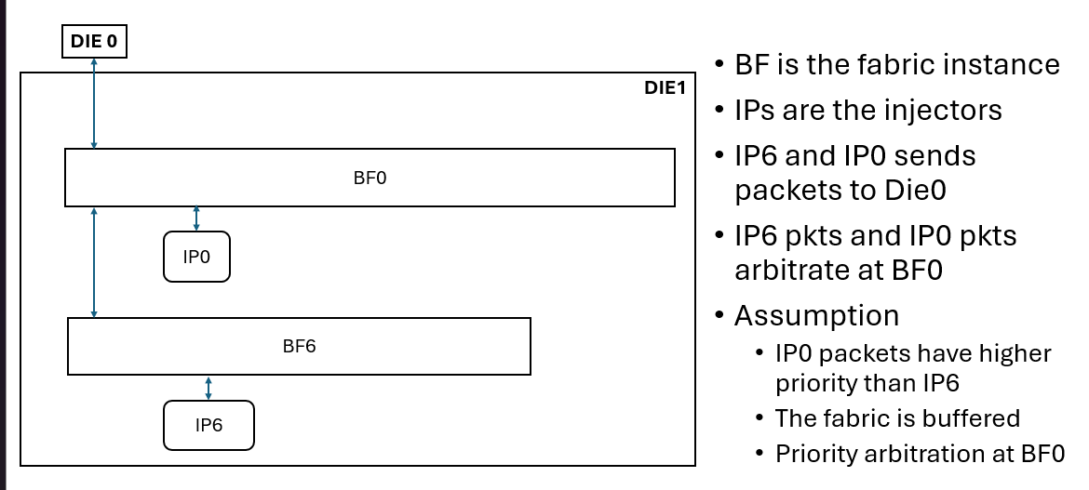
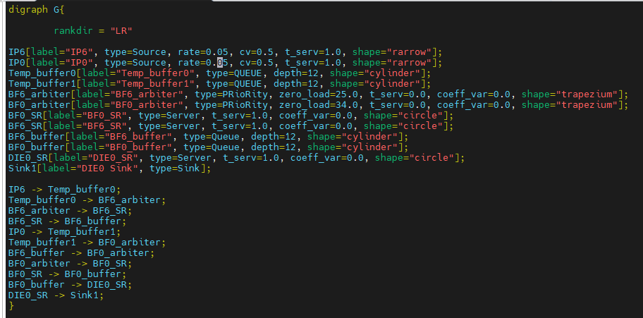
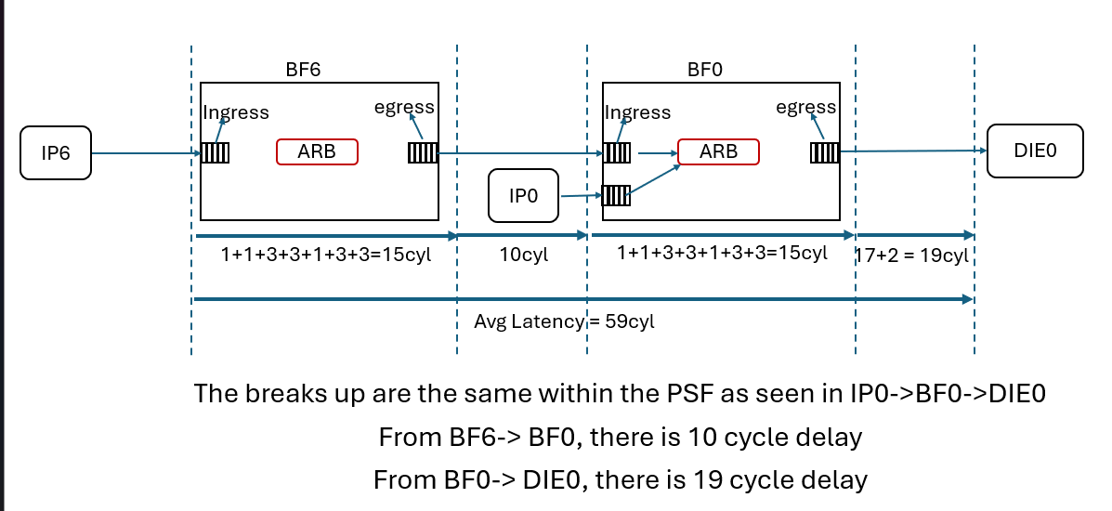
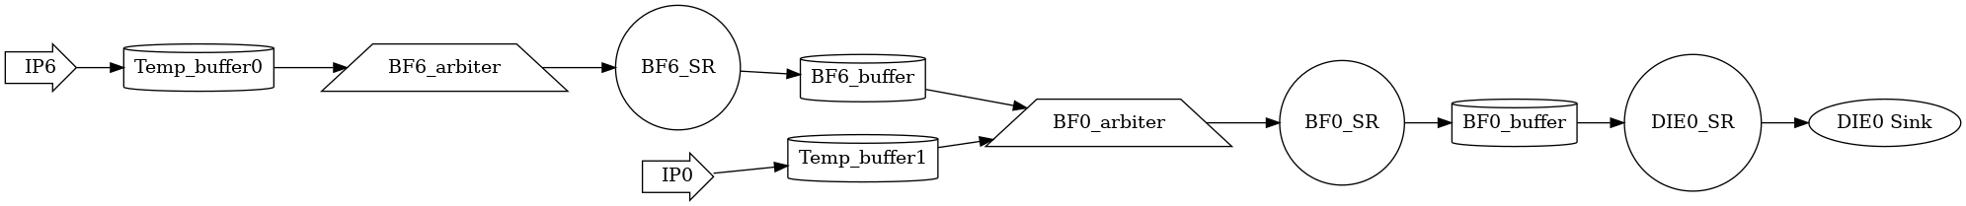
Experimental Summary
Exp 1: IP0 -> BF0 -> DIE0 (IP6 inactive) [waiting time = pipelining delay]
Exp 2: IP6 -> BF6 -> BF0 -> DIE0 (IP0 inactive) [waiting time = pipelining delay]
Exp 3: IP0 -> BF0 -> DIE0 & IP6 -> BF6 -> BF0 -> DIE0
Low / Low -> Minimal waiting
High / Low -> IP6 waits more
High / High -> Heavy contention at BF0
Buffer size = 12
Results aligned with FlexNoC output.

Slide 3
Ongoing Work – Mesh Topology Issue
Identified Issues
Automatically generated split probability is not correct
For PE0, correct path generated.
For other PEs, path generation is incomplete.
Ongoing work
Currently checking routing/path generation logic.
Verifying connections between routers and PEs.
Wrote a manual 2×2 mesh topology file from scratch.
Running it to compare with automatic mesh output.

Slide 4
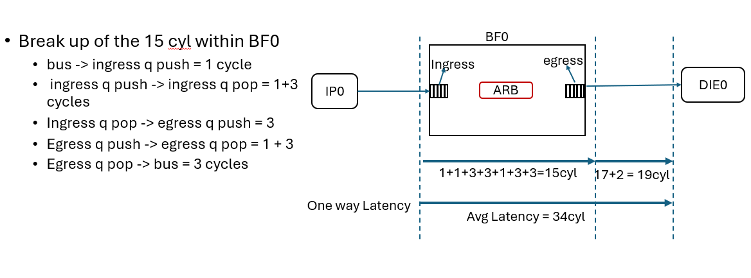
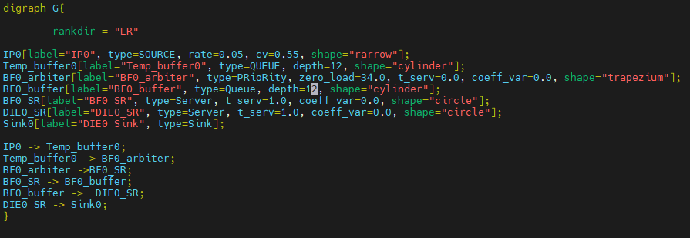

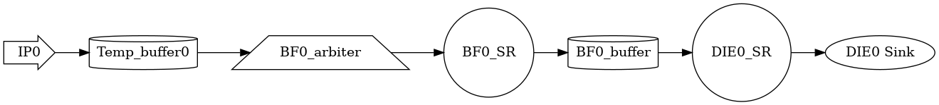
Experiment 1 : IP0->BF0->DIE0; NO IP6
Buffer size = 12
IP6 is inactive and doesn’t send any packets into the fabric
o/p from FlexNoC
.dot input file
Autogenerated png file

Slide 5
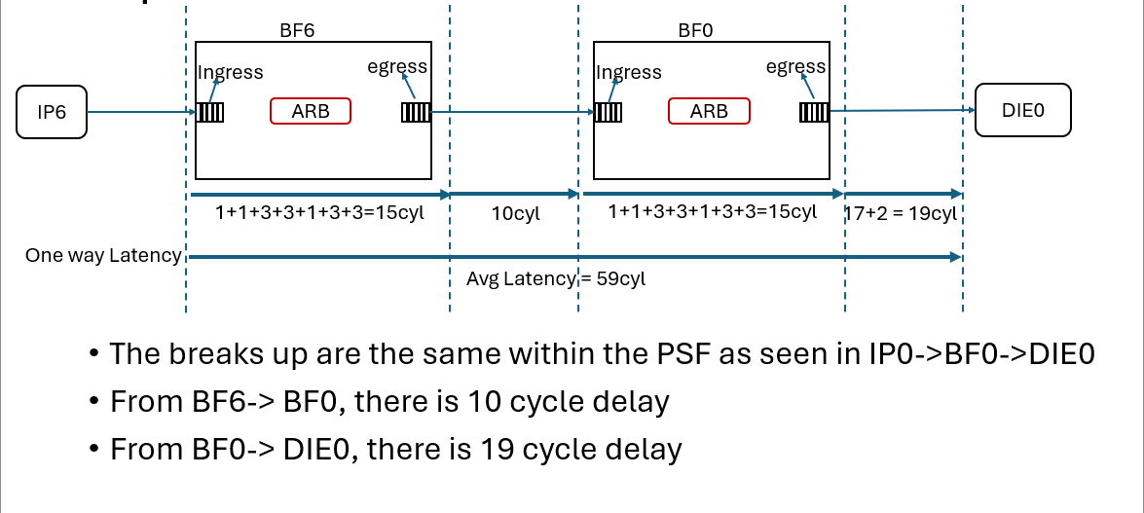
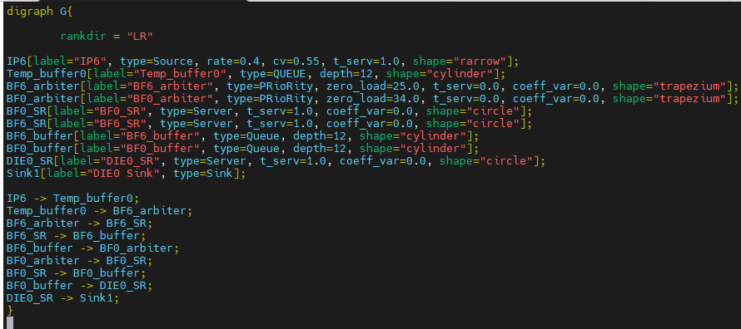

Experiment 2 : IP6->BF6->BF0->DIE0; NO IP0
Buffer size = 12
IP0 is inactive and doesn’t send any packets into the fabric
o/p from FlexNoC
.dot input file
Autogenerated png file

Slide 6
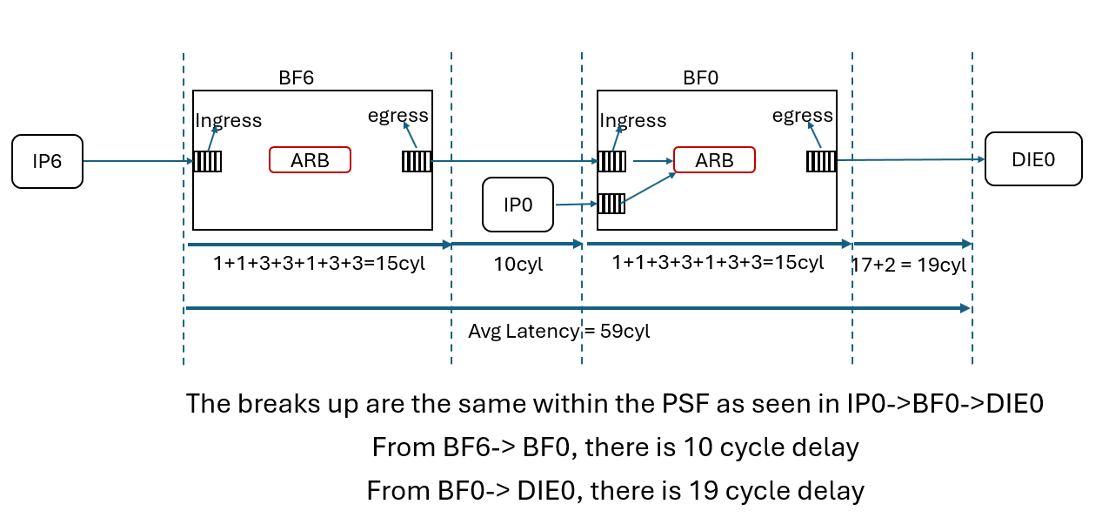
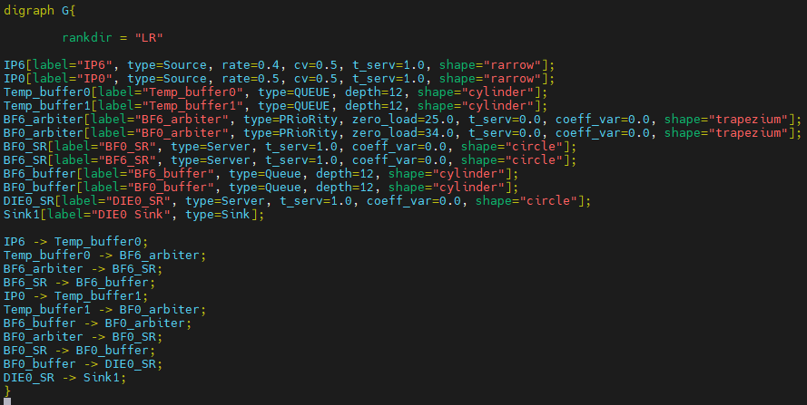
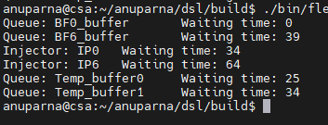
Experiment 3(b): Both IP6 & IP0 has high injection rate
Buffer_ size = 12
IP0 has higher priority than IP6.
IP0 ‘s end-to-end latency = queue waiting time + pipeline delay = 0(BF0 -> DIE0) + 34 = 34
IP0’s waiting time 0 as IP0 has high priority, need not to wait.
IP6 ‘s end-to-end latency = queue waiting time + pipeline delay = 5 +25(BF6 -> BF0) + 34 (BF0 -> DIE0)= 64

Slide 7
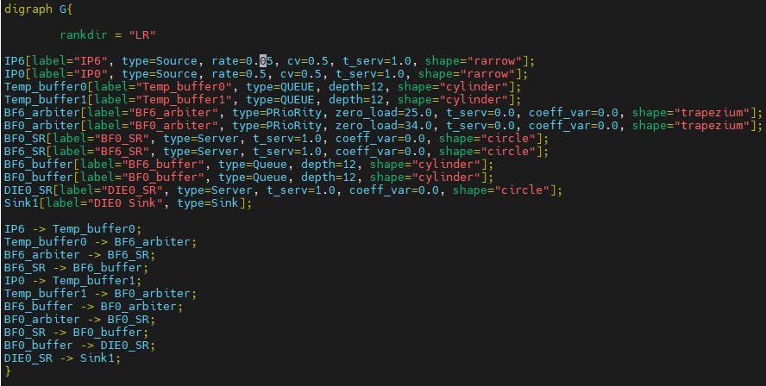
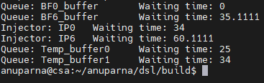
Experiment 3(b): IP6 has lower injection rate & IP0 has high injection rate
Buffer_ size = 12
IP0 has higher priority than IP6.
IP0 ‘s end-to-end latency = queue waiting time + pipeline delay = 0(BF0 -> DIE0) + 34 = 34
IP0’s waiting time 0 as IP0 has high priority, need not to wait.
IP6 ‘s end-to-end latency = queue waiting time + pipeline delay = 1.11 +25(BF6 -> BF0) + 34 (BF0 -> DIE0)= 60.11

Slide 8
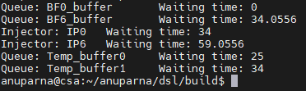
Experiment 3(a): Both IP6 & IP0 has lower injection
Buffer_ size = 12
IP0 has higher priority than IP6.
IP0 ‘s end-to-end latency = queue waiting time + pipeline delay = 0(BF0 -> DIE0) + 34 = 34
IP0’s waiting time 0 as IP0 has high priority, need not to wait.
IP6 ‘s end-to-end latency = queue waiting time + pipeline delay = 0.05 +25(BF6 -> BF0) + 34 (BF0 -> DIE0)= 59.05

